Slide 1
hjnfgcjhfj
Dgdfhfghfg hg rttrggbbnvnvbnvbnvnvbngh nhghhhfghf

Slide 2
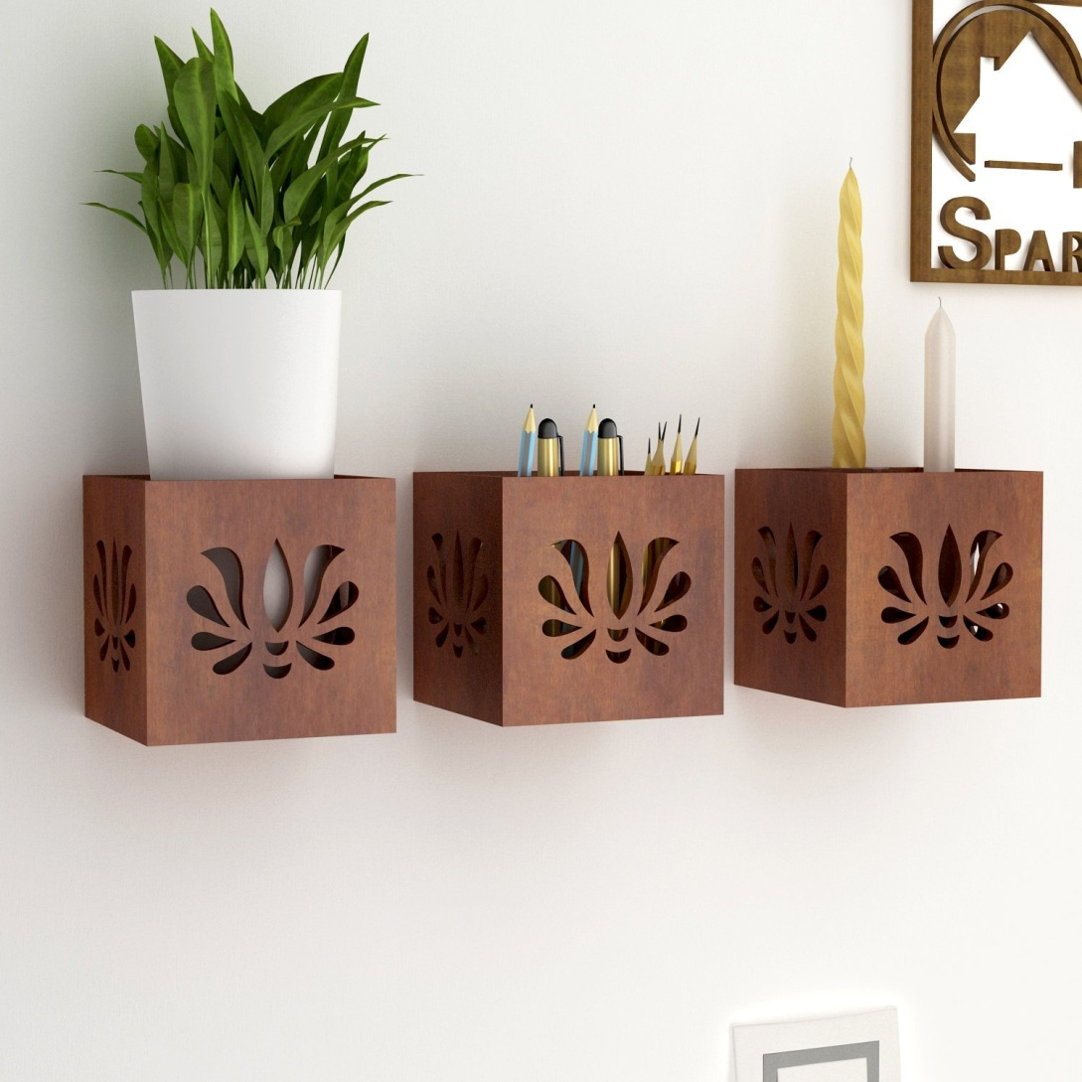
trtetertgdrtrte

Slide 3
tgertrtg
Ttergrete fghfhg hghf hfghfghfgh fghfhfghfghfghfhfghfhfghf hgfhfghgrtfg hghg hhgf h ytrtgrf

Slide 4
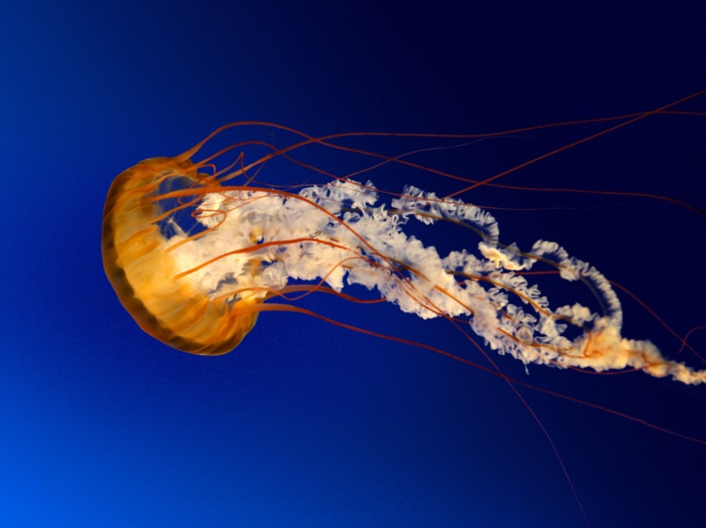
Fhfgh hgfhf fhfghf
Hfghfg hfgh fgh fghfgfhfhfghfg fhfghfghfghfghfhfhfghfghfghfghfhfghfghfhfhfghfg hgf hfhfhg

Slide 5


