Slide 1

M. Tech. Dissertation Viva-Voice Exam
Comparative study of Enhanced Power Flow Controller and TCSC
Submitted by:
Vivek Kumar
Roll no :- 16EREPS605
M.Tech, Power System
Supervised by:
Mr. Ashish Jaiswal
Department of Electrical Engineering
RIET, Jaipur

Slide 2
CONTENTS
Introduction
FACTS Controller
D-FACTS Controller
Comparison between FACTS and D-FACTS Controllers
Enhanced Power Flow Controller (EPFC)
EPFC MATLAB/Simulink model
Results
Conclusion
Future work and Scope
Publications
References

Slide 3
INTRODUCTION
As the power demand is growing dramatically, and extension in transmission and generation is restricted with the limited availability of resources and environmental constraints.
Power system engineers have to find out new alternatives to fulfil that increased demand.
This causes the power systems to be operated near stability limits because new system development have restrictions like high capital cost, land and time.
In order to minimize these problems, FACTS controller technology is used.
Contd…

Slide 4
Recently, an alternative approach based on cost-effective and scalable series impedance device that named as D-FACTS has been presented.
EPFC (Enhanced Power Flow Controller) is a series D-FACTS device which is distributed version of TCSC FACTS device.

Slide 5
FACTS DEVICE
Flexible
Alternating
Current
Transmission
System
FACTS are a collection of power transmission control technologies based on very high solid state power electronic devices.

Slide 6
FACTS-DEFINATION
Flexible AC Transmission System (FACTS) are the name given to the application of power electronic devices to control the power flows and other quantities in power system.
IEEE Definitions
FACTS: Flexible AC transmission system incorporating the power-electronic based and other static controllers to enhance controllability and increase the power transfer capacity.
FACTS Controllers: A power electronic based system & other static equipment that provide control of one or more AC transmission parameters.

Slide 7
WHY FACTS CONTROLLERS?
Enhances controllability and power transfer capability.
High speed response.
Controls line impedance, voltage and power flow.
Increases system security.
Provides greater flexibility.
Balances reactive power.
Increase the stability of power transmission over long distances

Slide 8

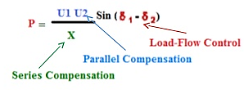
POWER TRANSFER
U1, 1 P U2, 2
G G
X

Slide 9
CONTROLLABLE PARAMETERS FOR FACTS DEVICES
Control of the line reactance X can provide a powerful means of current control.
When the angle is not large, which is often the case, control of X or the angle substantially provides the control of active power.
Control of angle, which in turn controls the driving voltage.
Injecting a voltage in series with the line, and perpendicular to the current flow, can increase or decrease the magnitude of current flow. Contd….

Slide 10
CONTROLLABLE PARAMETERS FOR FACTS DEVICES
Injecting voltage in series with the line and with any phase angle with respect to driving voltage can control the magnitude and phase of the line current.
When the angle is not large, controlling magnitude of one or the other line voltages can be very cost effective means for the control of reactive power flow through the inter-connection.
Combination of the line impedance control with a series controller and voltage regulation with a shunt controller can also provide a cost effective means to control both active and reactive power flow between the two systems.

Slide 11
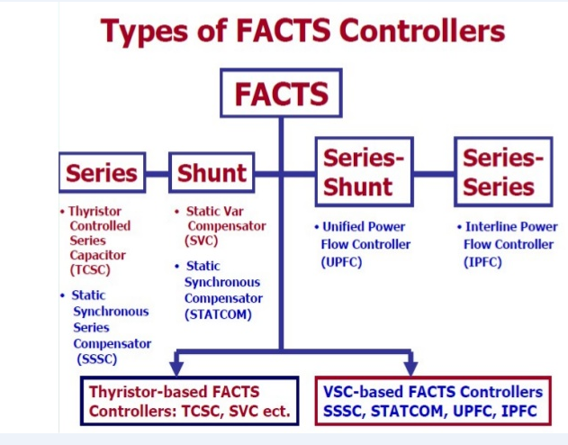
FACTS CATEGORIZATION

Slide 12
GENERATION of FACTS CONTROLLER
First generation of FACTS:
Second generation of FACTS:
Third generation of FACTS:
SSSC
D-STATCOM
SVC
STATCOM
TCSC
DPFC
UPFC
TCPST
EPFC
IPFC

Slide 13
FACTS CONTROLLERS
FACTS devices are typically high-power, high-voltage power controllers, operating at 138–500 kV and 10–300 MVA, that are used to enhance power flow in the transmission and distribution network.
However, high costs and reliability concerns associated with implementing one large FACTS device capable of altering the power flow in a wide transmission network have limited widespread deployment of FACTS solutions.
Recently, The Distributed-FACTS (D-FACTS) controller is presented as a new approach to realize cost-effective power flow control through compound, small, fixed series impedance injections.

Slide 14
LIMITATIONS OF FACTS CONTROLLER
High total cost of Installation.
High fault currents (60000 Amps) and insulation requirements (1000 kV) stress the PE system, making the implementation of FACTS systems, in particular series devices is very difficult and expensive.
Single point of failure yields reliability of 94% significantly lower than the 99.99% reliability that is typical for the utility system itself.
Highly customized design of FACTS devices requires skilled work-force in the field of maintain and operate the system. Contd…

Slide 15
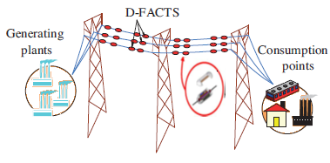
D-FACTS CONTROLLER
D-FACTS are distributed version of conventional FACTS controllers, which are distributed over whole transmission line as small modules at every short span of length.
. Contd…

Slide 16
D-FACTS CONTROLLER
D-FACTS controllers are 50-60 kg. and 10 kVA small modules.
These modules are directly connected (doesn’t require any break-in the line) to transmission line by using single turn transformer (STT).
Secondary side of STT contains a parallel connection of inductor and capacitor that are controlled by back to back connected PE switches which can be controlled by conduction angle control technique.
There is an extra PE switch pair which works in faulty period to by-pass the current and it saves the device from damage.

Slide 17
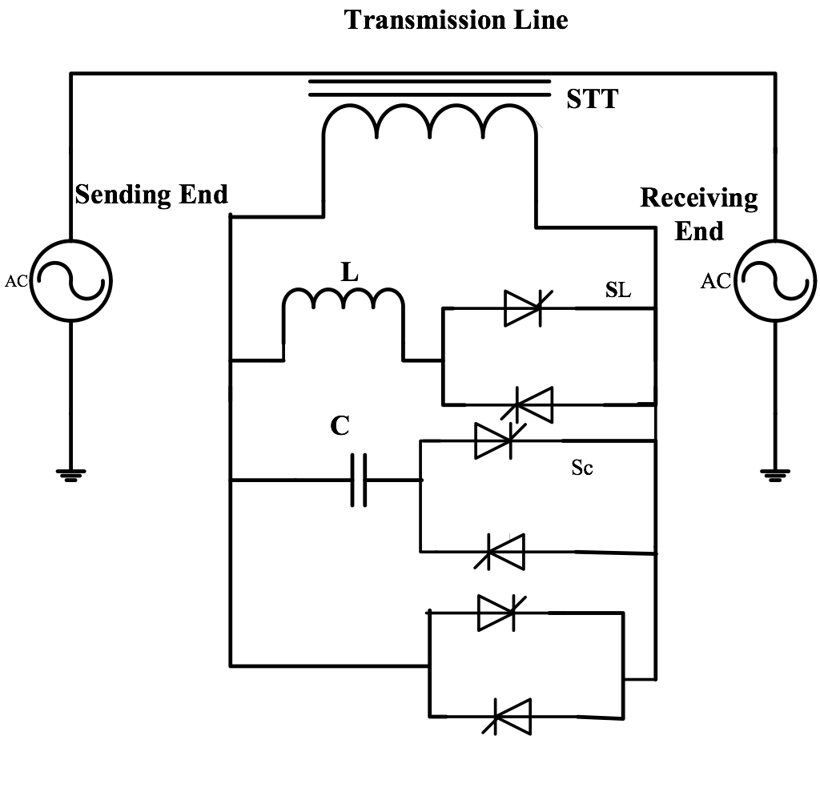
SIMPLIFIED SCHEMATIC OF D-FACTS
S

Slide 18
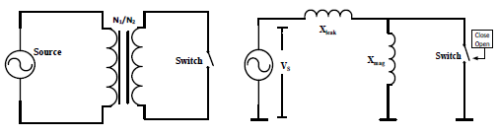

Simplified schematic of a STT and its equivalent circuit as reflected on the primary side
If the source voltage applied to the primary side of the transformer is V_{s}, and a back to back thyristor switch connected across the secondary side. Let the primary to secondary turns ratio be N₁/N₂, and X_{L1} and X_{L2} are leakage reactance’s of primary and secondary windings respectively, and X’_{mag} is magnetizing reactance of windings. Reflecting the secondary side circuit of EPFC, on the primary side, results in an equivalent circuit giving the following:
(1)
S

Slide 19



when the switch S is closed, equivalent reactance as seen by the source is given as:
(2)
when the switch S is opened, equivalent reactance as seen by the source is given as:
(3)
Thus effective line reactance is given (When switch S is closed and opened respectively) as:
(4)
(5)
This technique of impedance injection in transmission line is called Distributed Series Reactance (DSR).

Slide 20
COMPARISION BETWEEN FACTS AND D-FACTS
Cost Comparison:
S. No. | Controller Name | Cost (USD/ Kvar)
1 | SVC | 40$/ Kvar (controlled portions)
2 | TCSC | 40$/ Kvar (controlled portions)
3 | STATCOM | 50$/ Kvar
4 | UPFC series part | 50$/ Kvar (through power)
5 | UPFC shunt part | 50$/ Kvar (controlled portions)
6 | EPFC (D-FACTS) | 20$/ Kvar (Bi-directional control) Contd…

Slide 21
COMPARISION BETWEEN FACTS AND D-FACTS
Power Rating and Weight:
S. No. | Constraints | Conventional FACTS | D-FACTS
1. | Power rating | 10-300 MVA per module | 10 KVA per module
2. | Weight | 280-300 kg /10 KVA (average) | 50-60 kg. per module Contd…

Slide 22
COMPARISION BETWEEN FACTS AND D-FACTS
S. No. | Characteristics | Conventional FACTS | D-FACTS
1 | Break-in the Line | Required | Doesn’t Require
2 | Cost | Costlier than D-FACTS | cheap
3 | Size | Much larger than D-FACTS | Small modules (can be mounted on line)
4 | Nature | Lumped | Distributed over whole Line
5 | Weight | Much higher (80-90 tons) | Very less around (50-60) per module
6 | Best Location to use | Can be used at sending end or receiving end or both | Used on very small span of line about
7 | Control arrangements | Complex | Easy
8 | Maintenance | Required and costly | Doesn’t require, if required than not too costly
9 | Repair Time | Mean time to repair is much | Repaired single module which doesn’t affect the line performance so no time required
10 | Conventional transmission line | Cannot be used, it requires some changes. | Conventional Transmission line can be used
11 | Effects of fault on devices | May get damaged | By-passes the current so no chances to get damaged
12 | Single point failure effect | Entire system may get damaged | No effect of Single point failure
13 | Future up gradation on increment of demand | Not compatible | Compatible and easily upgradable
14. | Work force | Skilled workforce required | Doesn’t require because it can be repaired in factories as it is small in size (or can be replaced)

Slide 23
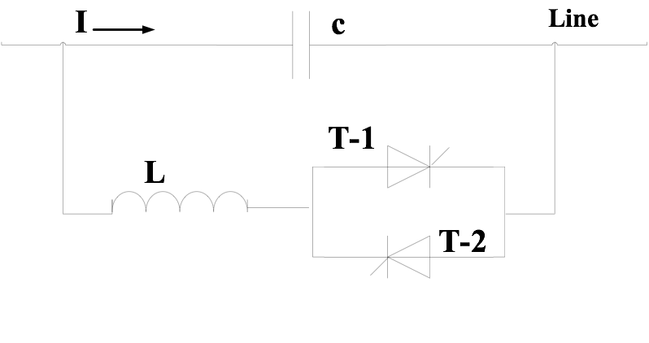
THYRISTOR CONTROLLED SERIES CAPACITOR (TCSC)
TCSC is a series capacitive reactance compensator which consists of a series capacitor bank shunted by a thyristor controlled reactor in order to provide a smoothly variable series reactance.

Slide 24
ENHANCED POWER FLOW CONTROLLER (EPFC)
EPFC is simply a distributed version of TCSC FACTS controller that is distributed over whole transmission line to work as D-FACTS controller.
EPFC is derived from TCSC FACTS controller; inherently gets all the controlling characteristics from TCSC.
All modules are independent and have their own capacitor used to provide the required line compensation.
EPFC is capable to control line impedance (z) and transmission angle by controlling the conduction angle of connected PE switches. Contd…

Slide 25
Transmission line is the only common link between the AC ports of converters.
Therefore, it is possible to exchange the power through AC terminals of the converters via transmission line.
It offers low cost because of low component rating of series converters.
High reliability because of the redundancy of the TCSC series converters. Contd…

Slide 26
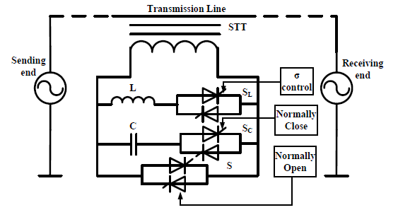
Simplified schematic of proposed EPFC controller
EPFC has three PE switches SL ,SC and S, in which S is normally open, SC is normally closed and SL is made to control by using conduction angle control technique.

Slide 27
EPFC CONTROLLER
EPFC mainly controls the impedance (z) of transmission line and alters the power flow.
The conduction angle of switch is controlled by pulse generated from controller which works on the basis of voltage control method by sensing the load voltage and comparing it to the reference voltage.
EPFC mainly works in two modes of operation.
By-pass mode
Compensation mode

Slide 28
BY-PASS MODE
Whenever fault or any unbalance takes place in the system than only the EPFC works in bypass mode of operation to avoid any type of damaging in it’s own circuitry because of high order of fault current.
The fault current is the order of 60000 Amps. (75000 peak) and it may cause harm to the control circuitry and switches.
so it is essential to change over to by-pass mode for safety of device.
During this mode of operation switch S is closed so no current flows EPFC and it is safe during the high current flow. Contd…

Slide 29

BY-PASS MODE
A secondary protection is provided for stroke period and faulty conditions as a break-over device that is attached between outer casing of transformer and cable to provide changed path for current flow.
The total inserted reactance (Xinserted) during this mode of operation is:
(6)

Slide 30
COMPENSATION MODE
During compensation mode of operation the EPFC controller works to change the impedance of transmission line so the power flowing through the line can be changed.
During compensation mode of operation switch S is normally open and switch SC is normally closed always.
Switch SL is used to control the insertion of total effective impedance in line by conduction angle control technique.
During compensation mode EPFC has two working modes:
Inductive mode
Capacitive mode

Slide 31
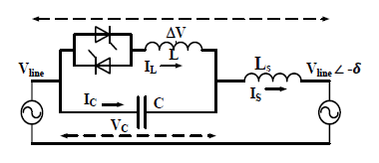

EQUIVALENT CIRCUIT OF EPFC DURING COMPENSATION MODE
Inductive mode: to decrease the power flow through line by increasing the impedance of line. When inductive reactance is less than the capacitive reactance (XL<XC) in EPFC controller then it works in inductive mode.
Total inserted effective reactance during inductive mode:
(7)
Contd…

Slide 32
Capacitive mode: to increase the power flow through line by decreasing the transmission line impedance. When inductive reactance is higher than the capacitive reactance (XL>XC) in EPFC controller then it works in inductive mode.
Total inserted effective reactance during inductive mode:
(8)
When switch SL is also connected with switch SC then total effective inserted reactance is:
(9)

Slide 33
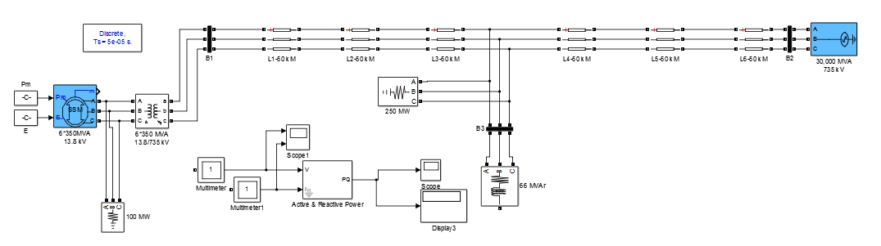
MATLAB/SIMULINK MODEL WITHOUT EPFC

Slide 34
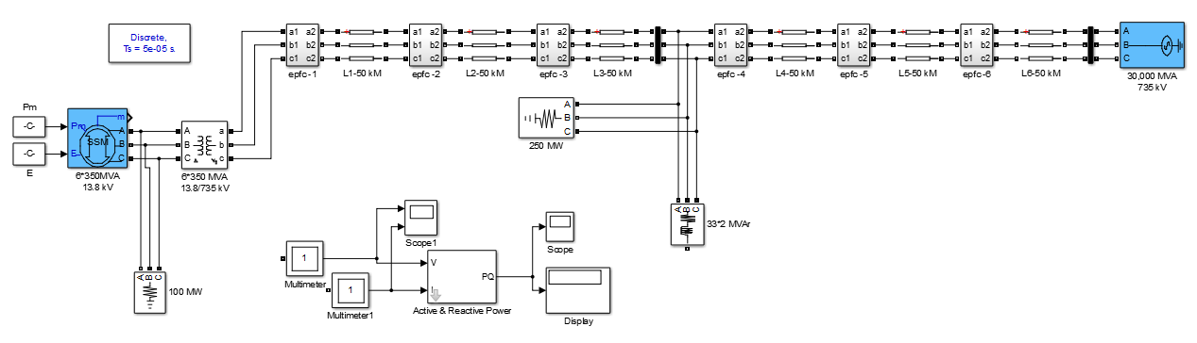
EPFC MATLAB/SIMULINK MODEL
Contd…

Slide 35
EPFC MATLAB/SIMULINK MODEL
This MATLAB/Simulink is developed for simple three phase 300 km long transmission line connected with six 350 MVA generators connected to the load.
In this model 2100 MVA at 13.8 kV simplified synchronous machine with a 30,000 MVA at 735 kV voltage source are taken in to consideration and voltages are increased up-to 735 kV for transmission by using three phase step-up transformer.
At every 50 km of line span EPFC modules are connected as distributed series controllers utilizing D-FACTS concept.
Contd…

Slide 36
EPFC MATLAB/SIMULINK MODEL
All the EPFC modules are connected at regular distance of every 50 km length, total six EPFC controller modules are used which are coordinated to each other to control the power flow in the transmission line.
During the simulation and result analysis of the EPFC it is observed that working characteristics are identical to the TCSC FACTS controller.

Slide 37
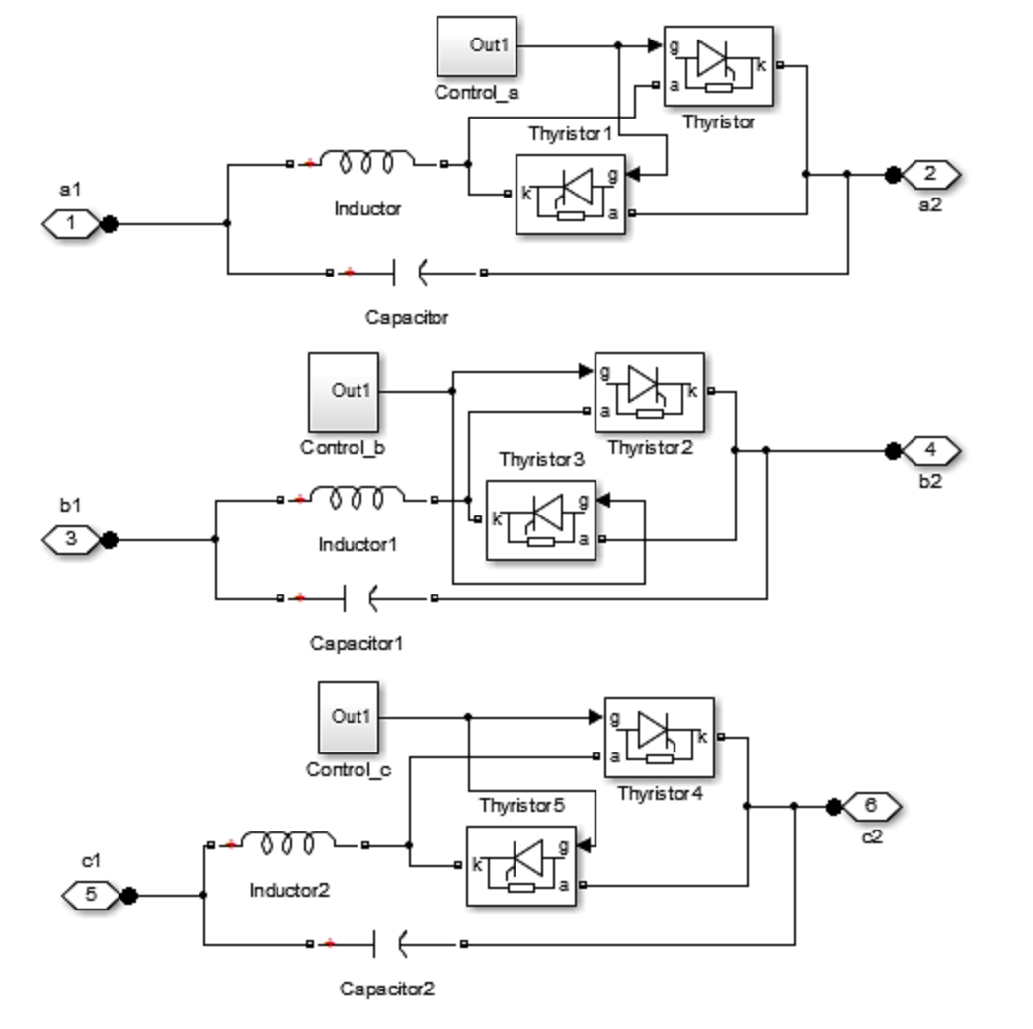
EPFC SUB-SYSTEM
Contd…

Slide 38
EPFC SUB-SYSTEM
EPFC module contains a inductor with back to back connected thyristor switches in parallel with capacitor.
Both thyristors are controlled by controller, which works on the basis of voltage control technique and gives a signal whenever voltage increases above the reference value.
The control signal controls the switches, which controls the effective reactance of EPFC controller.
The parallel connection of inductor and capacitor makes EPFC to work in both inductive and capacitive mode.
Every phase line has its own EPFC controller modules to control them line reactance.

Slide 39
RESULTS
During bypass mode of operation the power delivered at 66 MVAR load is around 61.5 MVAR at 735 kV voltage.
The EPFC modules can work in capacitive and inductive mode of operation, although the inductive mode of operation is rarely used in practice.
The power delivered can be increased up to 64.03 MVAR during capacitive mode of operation and can be decreased at 13.8 MVAR during inductive mode of operation by changing the impedance of line.
The nominal compensation is around 75% of transmission line impedance i.e. using only the capacitor.
Contd…

Slide 40
RESULTS
The total impedance of transmission line is 40.15 ohms without the EPFC modules.
The EPFC works in capacitive mode at 0° conduction angle, results in minimum impedance which is 12.37 ohms.
Impedance is maximum around 180° conduction angle, which is 56.03 ohms, when EPFC module is in inductive mode.
The resonance takes place in EPFC around 118° conduction angle, the operation is prohibited in conduction angle range 100-150°.
The change in Impedance, line current, active power and re-active power with conduction angle are as:

Slide 41
CHANGE IN IMPEDANCE WITH CONDUCTION ANGLE
Impedance (Ohms)
Conduction Angle

Slide 42
CHANGE IN LINE CURRENT WITH CONDUCTION ANGLE
Current (Amps.)
Conduction Angle

Slide 43
CHANGE IN ACTIVE POWER WITH CONDUCTION ANGLE
Active Power (W)
Conduction Angle

Slide 44
CHANGE IN RE-ACTIVE POWER WITH CONDUCTION ANGLE
Reactive Power (Var)
Conduction Angle

Slide 45
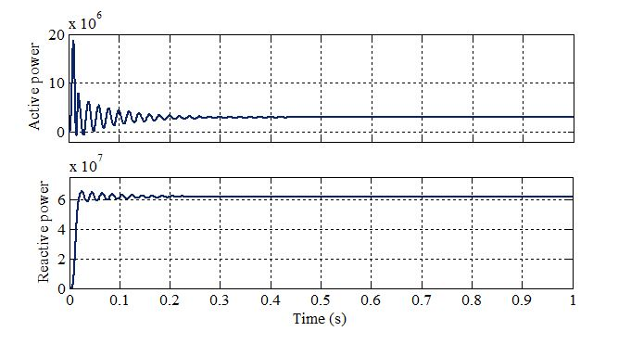
ACTIVE AND REACTIVE POWER DURING BY-PASS MODE (WITHOUT EPFC)

Slide 46
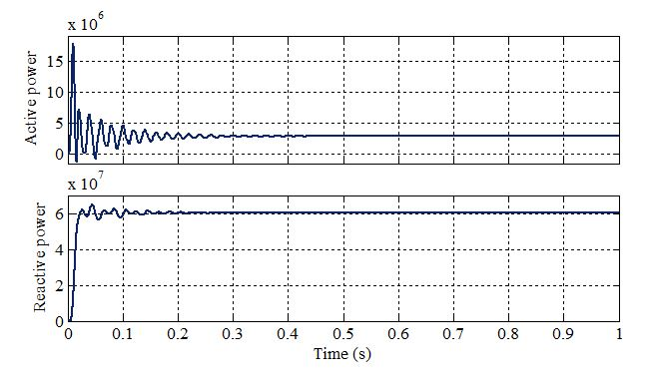
ACTIVE AND REACTIVE POWER AT 0° CONDUCTION ANGLE

Slide 47
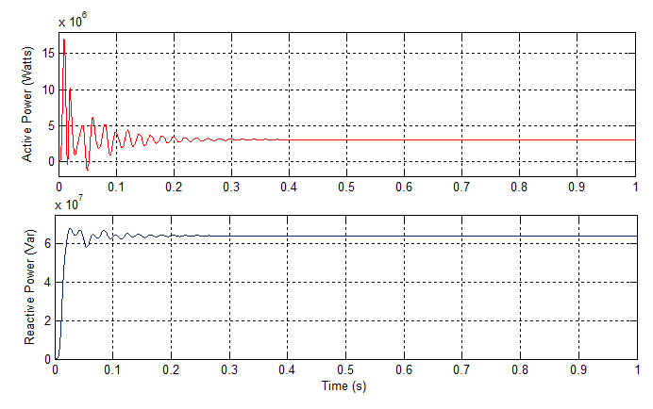
ACTIVE AND REACTIVE POWER AT 40° CONDUCTION ANGLE

Slide 48
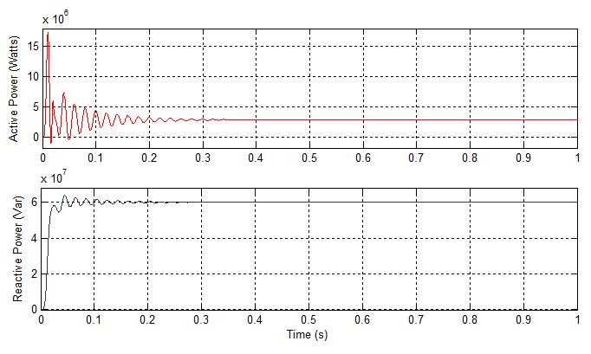
ACTIVE AND REACTIVE POWER AT 80° CONDUCTION ANGLE

Slide 49
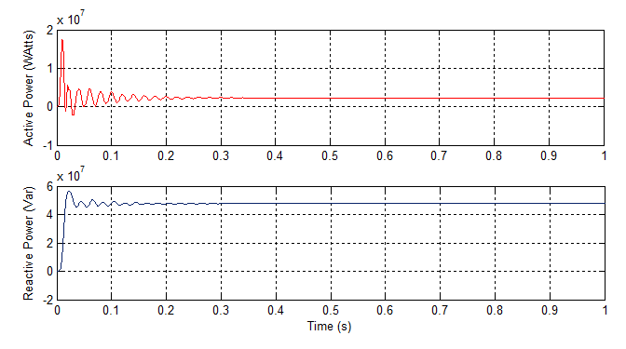
ACTIVE AND REACTIVE POWER AT 150° CONDUCTION ANGLE

Slide 50
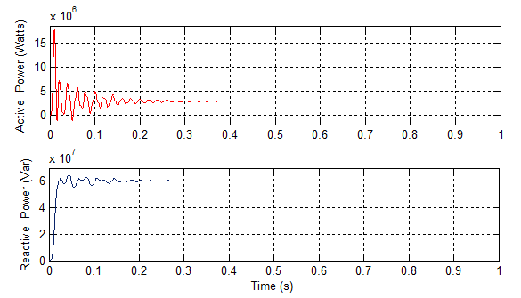
ACTIVE AND REACTIVE POWER AT 180° CONDUCTION ANGLE (FULL -CONDUCTION)

Slide 51
CHANGE IN IMPEDANCE, LINE CURRENT, ACTIVE AND REACTIVE POWER WITH CONDUCTION ANGLE
Conduction angle (Degree) | Impedance (Ohm) | Current (Amp.) | 3-phase Active Power (Watts) | 3-phase Reactive Power (Var)
180 | 56.03 | 49.57 | 2.89E+06 | 6.02E+07
170 | 58.09 | 48.09 | 2.61E+06 | 5.47E+07
150 | 66.78 | 44.12 | 2.29E+06 | 4.77E+07
100 | 61.95 | 41.09 | 1.95E+06 | 4.08E+07
80 | 40.5 | 49.48 | 2.88E+06 | 6.00E+07
60 | 24.78 | 51.03 | 3.05E+06 | 6.38E+07
40 | 18.44 | 51.12 | 3.07E+06 | 6.41E+07
20 | 14.66 | 51.04 | 3.06E+06 | 6.39E+07
0 | 13.8 | 51 | 3.06E+06 | 6.38E+07

Slide 52
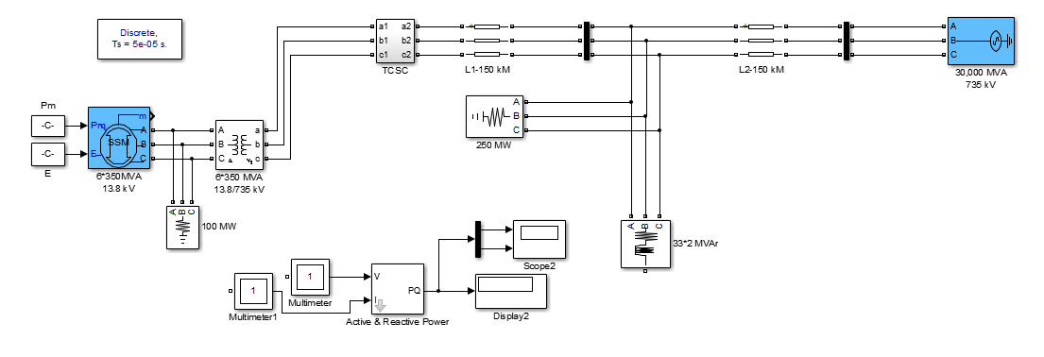
Simulation Model of TCSC

Slide 53
CHANGE IN IMPEDANCE WITH CONDUCTION ANGLE
Impedance (Ohms)
Conduction Angle

Slide 54
CHANGE IN LINE CURRENT WITH CONDUCTION ANGLE
Current (Amps)
Conduction Angle

Slide 55
CHANGE IN ACTIVE POWER WITH CONDUCTION ANGLE
Active Power (Watts)
Conduction Angle

Slide 56
CHANGE IN RE-ACTIVE POWER WITH CONDUCTION ANGLE
Reactive Power (Vars)
Conduction Angle

Slide 57
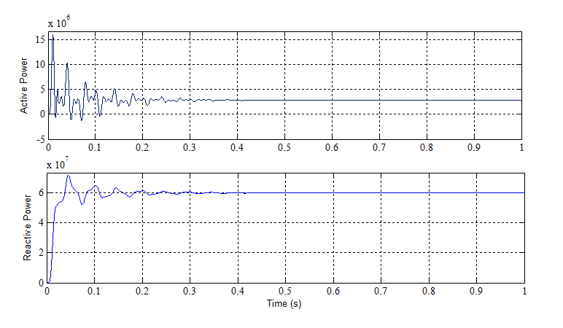
ACTIVE AND REACTIVE POWER AT 0° CONDUCTION ANGLE

Slide 58
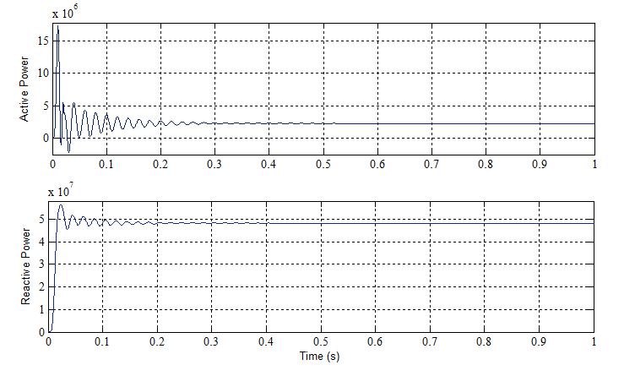
ACTIVE AND REACTIVE POWER AT 40° CONDUCTION ANGLE

Slide 59
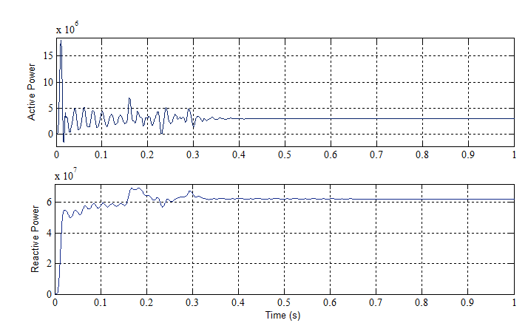
ACTIVE AND REACTIVE POWER AT 80° CONDUCTION ANGLE

Slide 60
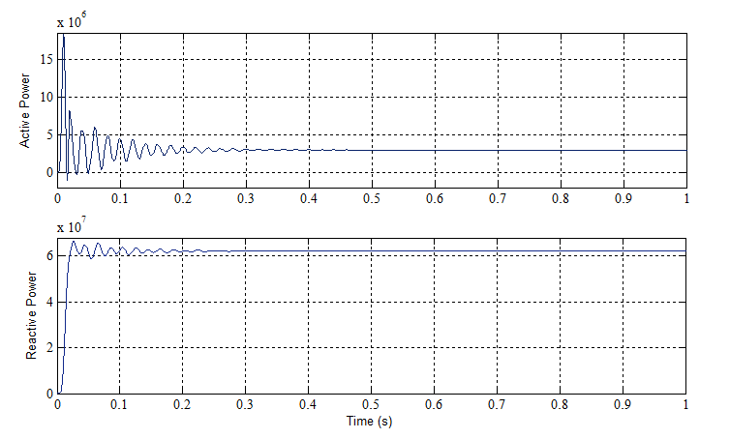
ACTIVE AND REACTIVE POWER AT 120° CONDUCTION ANGLE

Slide 61
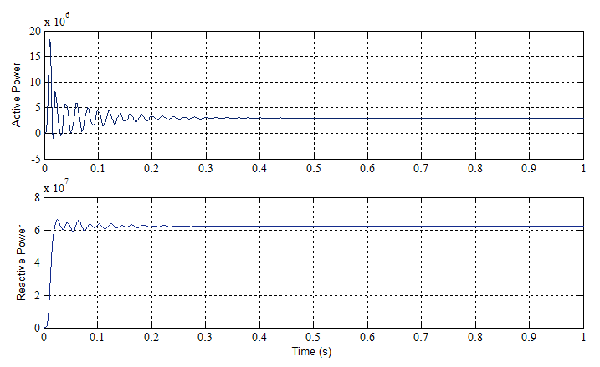
ACTIVE AND REACTIVE POWER AT 160° CONDUCTION ANGLE

Slide 62
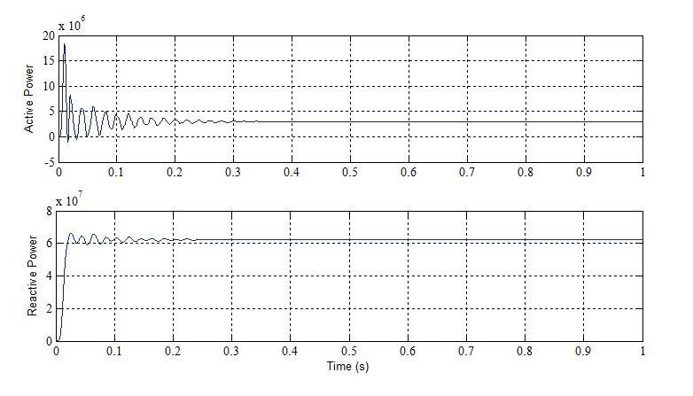
ACTIVE AND REACTIVE POWER AT 180° CONDUCTION ANGLE (Full Conduction Angle)

Slide 63
CHANGE IN IMPEDANCE, LINE CURRENT, ACTIVE AND REACTIVE POWER WITH CONDUCTION ANGLE
Conduction Angle (Degree) | Impedance (ohm) | Current (Amp.) | 3-Phase Active Power (Watts) | 3-Phase Reactive Power (Var)
180 | 77.9 | 50.4 | 2.98E+06 | 6.23E+07
160 | 77.9 | 50.4 | 2.98E+06 | 6.23E+07
140 | 77.9 | 50.4 | 2.98E+06 | 6.23E+07
120 | 77.9 | 50.4 | 2.98E+06 | 6.23E+07
100 | 82.88 | 50.42 | 2.98E+06 | 6.23E+07
80 | 100.2 | 50.43 | 2.98E+06 | 6.23E+07
60 | 40.51 | 49.82 | 2.73E+06 | 5.70E+07
40 | 39.4 | 44.37 | 2.31E+06 | 4.83E+07
20 | 40.81 | 43.63 | 2.257E+06 | 4.716E+07
0 | 10.01 | 49.36 | 2.86E+06 | 5.97E+07

Slide 64
CONCLUSION
EPFC provides better utilization of existing power transmission system, which uses the D-FACTS concept for power flow control instead of one large size FACTS controller.
The reliability of EPFC has increased due to redundancy of series controllers and the cost is also much lower than TCSC controller cause the rating of the controller is much lesser than lumped controller.
This work has presented a new model in MATLAB/Simulink with EPFC that emerges from TCSC series FACTS controller and inherits the control techniques of TCSC.
The EPFC Simulink model has been analysed and the results are shown as variation in transmission line impedance, line current, active power and reactive power at the load end with respect to conduction angle.
Contd…

Slide 65
CONCLUSION
The variation in active and reactive power is also shown with the comparison of TCSC.
A controlled transmission line implemented with multiple EPFC modules has significant benefits at a system level, which are:
enhance asset utilization;
reduce system congestion;
increase available transfer capacity (ATC) of the system.
Total cost reduction.

Slide 66
FUTURE WORK AND SCOPE
There are various possibilities for future work in the field of EPFC controller and load flow control in power system.
The control circuit can employ fuzzy controller, PR controller or adaptive PI fuzzy controller.
The devices can also be set to work on PV cells or wind power (renewable energy sources).
This work can also be extended for lesser duration gap modules in practical use.

Slide 67
PUBLICATIONS
Vivek Kumar, Ashish Jaiswal, “Comparative study of Enhanced Power Flow Controller and TCSC” International Journal of Applied Engineering Research (IJAER), Vol. 13, Issue 14, pp. 11625-11631, 2018.

Slide 68
REFRENCES
Brian Stott, “Review of load flow calculation methods”, Proceedings of The IEEE, Vol. 62, No. 7, pp. 916-929, U.K., 1974.
Frank S. Young, “Flexible AC Transmission Systems: Technology for the future”, IEEE Conference, pp. 216-219, Sao Paulo Alto, California, 1991.
M. Noroozian, G. Anderson, “Power flow control by use of controllable series components”, IEEE Transaction on Power Delivery, Vol. 8 (3), pp. 1420-1429, Jul. 1993.
Philip Moore, Peter Ashmole, “Flexible AC Transmission Systems”, Power Engineering Journal, Vol. 9 (6), pp. 282-286, Dec. 1995.
John J. Paserba, Nicholas, W. Miller, V. Einar, Larsen, Richard J. Piwko, “A Thyristor Controlled Series Compensation Model for Power System Stability Analysis”, IEEE Transactions on Power Delivery, Vol. 10 (3), pp. 1471-1478, Jul. 1995.
L. Gyugyi, C. Schauder, K. K. Sen, “static Synchronous Compensator A solid state approach to the series compensation of transmission lines”, IEEE Transactions, Vol. 12, No. 1, pp. 406-417, Jan. 1997.
Tjing T. Lie, Wanhong Deng, “Optimal Flexible AC Transmission Systems (FACTS) Devices Allocation”, Electrical Power & Energy System, Vol. 19, pp. 125-134, 1997.
N. G. Hingorani, L. Gyugyi, “Understanding FACTS, Concepts and Technology of Flexible AC Transmission Systems”, IEEE Press, Willey Publication, First Indian Edition, 2001.
X .P. Zhang, E. J. Handschin, “Optimal Power Flow Control by Converter based FACTS Controllers”, AC-DC Power Transmission, IEE Conference, pp. 250-255, Germany, 28-30 Nov. 2001.
Abdel Moamen Mohammed, Abdel Rahim Ahmed, “Optimal Power Flow with FACTS Device”, P.hd Thesis, IIT, Roorkee, pp. 1-308, 2004.

Slide 69
11. H. Johal, D. Divan, “Design Considerations for Series-Connected Distributed FACTS Converters”, IEEE Transactions on Industry App, Vol. 43(6), pp. 1609-1618, Dec. 2007.
12. Deepak M. Divan, William E. Brumsickle, Robert S. Schneider, Bill Kranz, Randal W. Gascoigne, Dale T. Bradshaw, Michael R. Ingram, Ian S. Grant, “A Distributed Static Series Compensator System for Realizing Active Power Flow Control on Existing Power Lines”, IEEE Transactions on Power Delivery, Vol. 22, No. 1, pp. 642-649, Jan. 2007.
13. M. A. Abido “Power System Stability Enhancement Using FACTS Controllers: A Review”, The Arabian Journal for Science and Engineering, Vol. 34, No. 1,pp. 75-91, Tehran, Iran, Nov. 2008.
Katherine M. Rogers, Thomas J. Overbye, “Power Flow Control with Distributed Flexible AC Transmission System (D-FACTS) Devices”, the Power System Engineering Research Centre, City Water Light and Power (CWLP) in Springfield, IL and the Grainger Foundation, pp. 1-6, 2009.
Kishor Porate, K. L. Thakre, “Distributed FACT Controllers as an Effective Tool for Reduction in Environmental pollution due to Thermal Power Plant, WSEAS Transactions on Power Systems, Vol. 4, Issue 3, pp. 85-94, Mar. 2009.
S. K. Shrivastva, “Advanced Power Electronics Based FACTS controllers: An Overview”, Asian Power Electronics Journal, Vol. 4, No.3, pp. 90-95, Dec. 2010.
V. Kakkar, N. Agrwal, “Recent trends on FACTS and D-FACTS”, Modern Electric Power Systems Conference, Wroclaw, Poland, pp. 1-7, 2010.
Zhihui Yuan, Jan Braham Ferreira, Dalibor Cvoric, “A FACTS Device: Distributed Power-Flow Controller (DPFC)”, IEEE Transactions on Power Electronics, Vol. 25, No. 10, pp. 2564-2573, Oct. 2010.
Mahdiyeh Eslami, Hussain Shareef, Azah Mohamed, Mohammad Khajeh zadeh, “A Survey on Flexible AC Transmission System (FACTS)”, PRZEGLĄD ELEKTROTECHNICZNY Journal (Electrical Review), pp. 1-11, 2012.
Sthitaprajna rath, Bishnu Prasad Sahu, Prakash Das, “Power System Operation and Control using FACTS Devices”, International Journal of Engineering Research & Technology (IJERT), Vol. 1, Issue 5, pp.1-5, Jul. 2012.
Contd…

Slide 70
J. Wang, Z. Wang, L. Xu, Z. Wang, “A Summary of Applications of D-FACTS on Microgrid”, IEEE Asia Pacific Power and Energy Engineering, Shanghai, pp. 1-6, 2012.
Satvinder Singh, Nitin Goel, Pawan Kumar, “FACTS Technologies for the Developments of Future Transmission Systems”, International Journal of Emerging Trends in Engineering and Development, Issue 3, Vol.2, pp. 587-595, Mar. 2013.
Viresh Kumar, G. Mathad, Basangouda, F. Ronad, Suresh H. Jangamshetti, “Review on Comparison of FACTS Controllers for Power System Stability Enhancement”, International Journal of Scientific and Research Publications, Vol. 3, Issue 3, pp. 1-4, Mar. 2013.
Chiranjit Jain, Dr. Saumitra Kumar Mandal, Sanjukta Dey, “Design and Analysis of and Analysis of Control Circuit for TCSC FACTS Controller”, International Journal of Engineering Research & Technology, Vol. 2, Issue 5, pp. 1353-1359, May. 2013.
Energy Statics Report, Central Statics office, “Ministry of Statics and Programme Implementation”, Govt. of India, 20th Issue, pp. 1-82, New Delhi, 2013.
Ganesh Barve, “Application Study of FACTS Devices in Indian Power System”, International Journal of Computing and Technology, Vol. 1 (1), pp. 57-59, Feb. 2014.
P. P. Tambe, K. D. Joshi, “Distributed Static Series Compensator (DSSC) Application to Power System - A Review”, International Journal of Power System Operation and Energy Management, Vol. 2, Issue. 1, pp. 5-8, 2014.
Alekhya Vaddiraj, Madhav Manjrekar, “Modelling and Analysis of an EPFC (enhanced Power Flow Controller) with Conduction Angle Control”, IEEE Conference, pp. 1-5, Hyderabad, India, 2014-a.
Dheeraj kumar Dhaked, Mahendra Lalwani, “A Comprehensive Review on a D-Facts Controller: Enhanced Power Flow Controller (EPFC)” International Journal of Advances in Engineering and Technology (IJAET), Vol. 10, Issue 1, pp. 84-92, Feb. 2017.
Dheeraj kumar Dhaked, Mahendra Lalwani, “A Comprehensive Review on a D-Facts Controller: Enhanced Power Flow Controller (EPFC)” International Journal of Advances in Engineering and Technology (IJAET), Vol. 10, Issue 1, pp. 84-92, Feb. 2017.
Vivek Kumar, Ashish Jaiswal, “Comparative study of Enhanced Power Flow Controller and TCSC” International Journal of Applied Engineering Research (IJAER), Vol. 13, No. 14 (2018), pp. 11625-11631.

Slide 71


